Slide 1

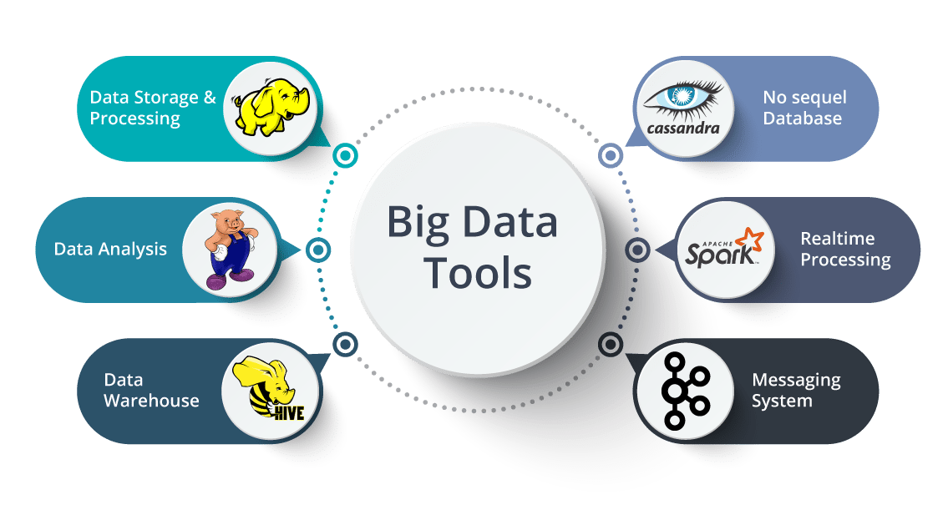
Big Data Storage and Processing MSc in Data Analytics CCT College Dublin
Apache Spark
Week 4 - 5
Lecturer: Dr. Muhammad Iqbal*
Email: miqbal@cct.ie

Slide 2
Agenda
Introduction to Apache Spark
Apache Spark: Components
Apache Spark Components: Spark SQL, Spark Streaming, MLib
RDD Basics and Spark File Based Input Methods
Comparison of Spark and Mapreduce
Spark Programming Paradigm
Spark and the Hadoop Environment
Apache Spark Architecture
Spark Programming Model
Dataframes and Spark SQL
Spark ML

Slide 3

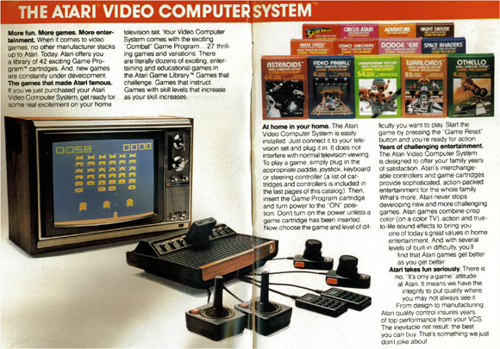
Introduction to Apache Spark
Jean-Georges Perrin (Author of a book Spark in Action) mentioned his experience in his book.
During his childhood in the 1980s, when he first learned how to program through Basic and my Atari, he could not grasp why automated traffic control, traffic light enforcement, and parking meter enforcement could not be automated.
From the age of 12, he was not clear about the volume of data. He created Monopoly and it fits in 64 KB of memory; however, the amount of data generated by this game is enormous if it is played by a large number of players.
All those use cases are still accessible online 35 years later. Data has increased at a faster rate than hardware that supports it. A cluster of small computers will cost less than one large one.
Networks are many times faster, and modern data centers offer speeds of up to 100 gigabits per second (Gbps), nearly 2,000 times faster than your home Wi-Fi from five years ago. These are some of the factors that drove people to ask this question:
How can we use distributed memory computing to analyze large quantities of data?
Notes:
The Atari 2600, branded as the Atari Video Computer System (Atari VCS) until November 1982, is a home video game console developed and produced by Atari, Inc. Released in September 1977, it popularized microprocessor-based hardware and games stored on swappable ROM cartridges, a format first used with the Fairchild Channel F in 1976

Slide 4
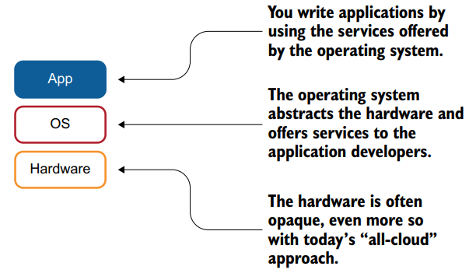
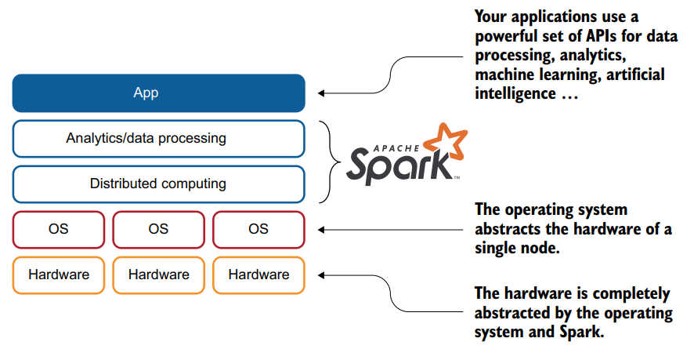
Introduction to Apache Spark
Apache Spark is more than a software stack for data scientists. When you build applications, you build them on top of an operating system, as illustrated in the figure.
The operating system provides services to make your application development easier; in other words, you are not building a filesystem or network driver for each application you develop.
Apache Spark simplifies the development of analytics-oriented applications by offering services to applications as an operating system does.

Slide 5
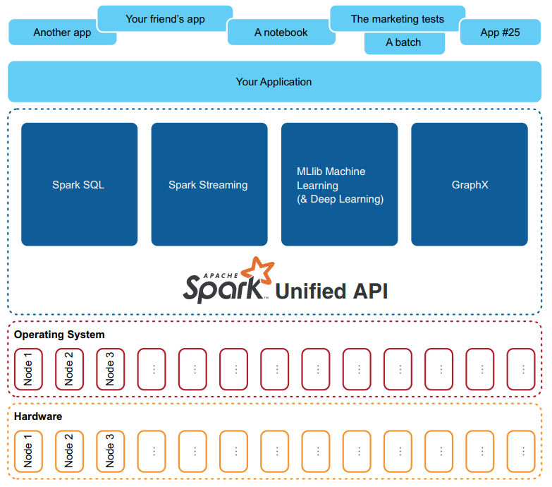
Introduction to Apache Spark
Apache Spark is a Java Virtual Machine (JVM) based on distributed data processing engine that scales, and it is fast compared to many other data processing frameworks.
Spark™ is a fast and general engine for large-scale data processing.
The biggest claim from Spark regarding speed is that it is able to “Run programs up to 100x faster than Hadoop MapReduce in memory, or 10x faster on disk”.
According to Apache Spark, it reduces disk I/O latency by carrying out all processing in the main memory of the worker nodes.
The other advantage of Spark offers is the ability to chain the tasks at an application programming level without writing onto the disks at all or minimizing the number of writes to the disks.
Spark was originated at the University of California Berkeley and later became one of the top projects in Apache.

Slide 6

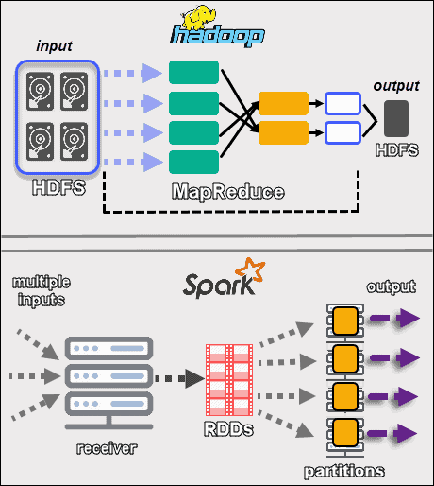
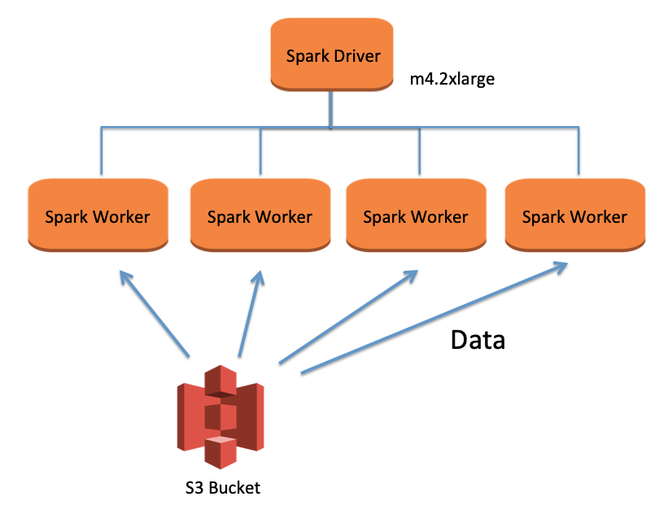
Introduction to Apache Spark
Apache Spark is a general-purpose, distributed cluster computing, data processing framework that, like MapReduce in Apache Hadoop, offers powerful abstractions for the processing of a large dataset.
Apache Spark is designed to work with Hadoop*, Amazon S3, Cassandra or as a standalone application.
Support languages for Spark: Scala, Java, Python and R
Rich set High level APIs and increases user productivity.
Integration with new & existing system.

Slide 7
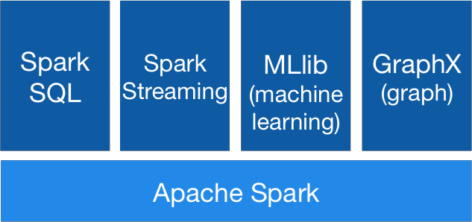
Introduction to Apache Spark
Big Data analytics platform - written in Scala
Supports wide range of analytics tasks
Load Data
SQL
ML
Streaming
Same computing engine!
Consistent set of APIs
Tasks are easier and more efficient to write
Spark can be deployed in a standalone mode on a single node having a supported OS.
Spark can also be deployed in cluster node on Hadoop YARN as well as Apache Mesos.
Spark can be deployed in the Amazon EC2 cloud as well.

Slide 8
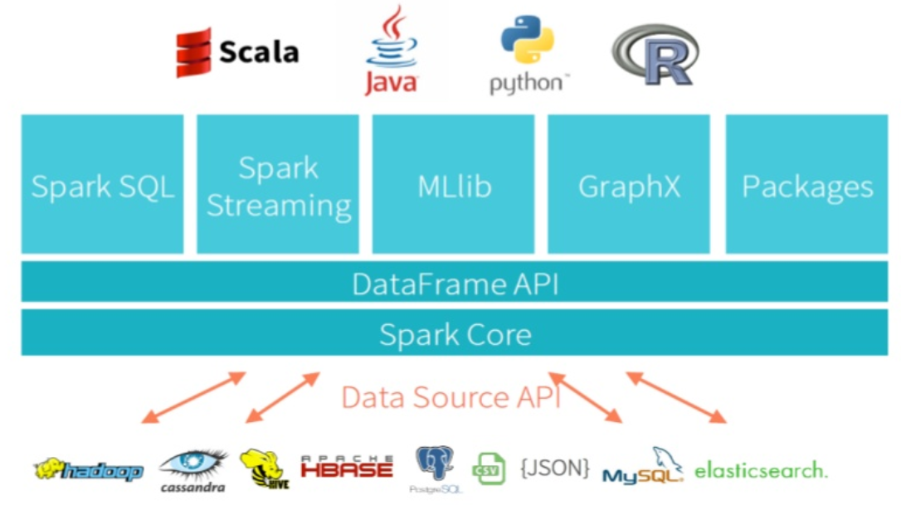
Apache Spark Components
The Spark core is complemented by a set of powerful and higher-level libraries
SparkSQL
Spark Streaming
MLlib (for machine learning)
GraphX
Packages (for example, SparkDL)
Scala is the language in which Spark is written.
Dataframe is equivalent to a table in a relational database
Spark Core is the base engine for large-scale parallel and distributed data processing. It is responsible for
memory management and fault recovery
scheduling, distributing and monitoring tasks, jobs on a cluster
interacting with storage systems

Slide 9
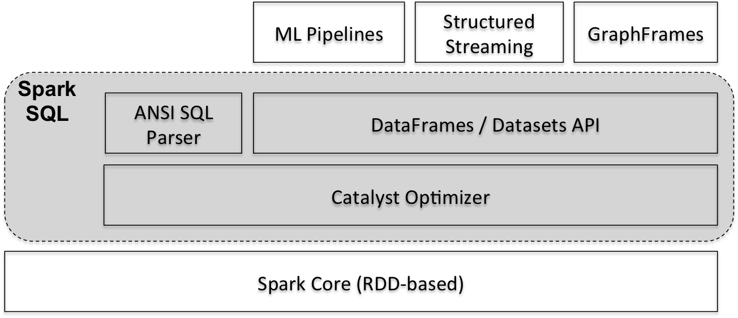
Apache Spark Component Spark SQL
SparkSQL is one of the most advanced components of Apache Spark.
In is clear from the figure that Spark SQL components provide the foundation for Spark machine learning applications, streaming applications, graph applications, and many other types of application architectures.
SparkSQL is a Spark component that supports querying data either via SQL or via the Hive Query Language.
It originated as the Apache Hive port to run on top of Spark (in place of MapReduce) and is now integrated with the Spark stack.
Below is an example of a Hive compatible query:
// sc is an existing
SparkContext.val sqlContext = new org.apache.spark.sql.hive.HiveContext(sc)
sqlContext.sql("CREATE TABLE IF NOT EXISTS src (key INT, value STRING)")
sqlContext.sql("LOAD DATA LOCAL INPATH 'examples/src/main/resources/kv1.txt' INTO TABLE src")
// Queries are expressed in HiveQL
sqlContext.sql("FROM src SELECT key, value").collect().foreach(println)

Slide 10
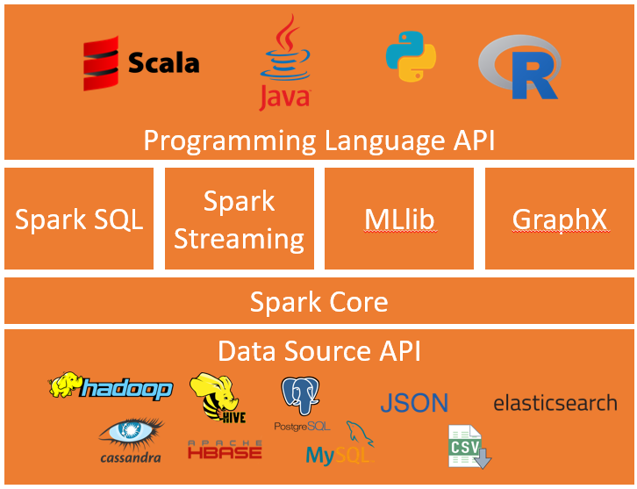
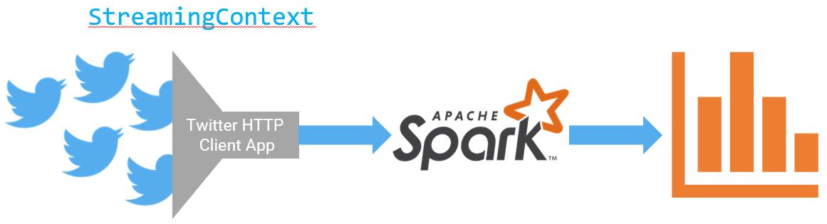
Apache Spark Component Spark Streaming
Data is generated continuously from one or many sources
Sources typically send in data simultaneously
Data comes in small packages (kilobyte scale) in succession
A lot of applications use continuously-updated data
Examples:
Sensors in vehicles, industrial equipment, and machinery send data to streaming for performance measurement.
Solar power company monitoring panel performance through streaming
Online gaming company collecting streaming data about player-game interactions
Spark streaming can use it to track most popular hashtags in 5 mins windows based on their counts in a Twitter stream, and by using the StreamingContext function.

Slide 11
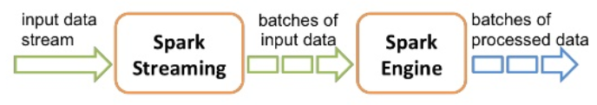
Apache Spark Component Spark Streaming
Spark Streaming supports real time processing of streaming data, Spark Streaming is an extension of the core Spark API that enables scalable, high-throughput, fault-tolerant stream processing of live data streams.
Data can be ingested: Kafka, Flume, Twitter, ZeroMQ, Kinesis or TCP sockets.
Processed data can be pushed out to filesystems, databases, and live dashboards. In fact, you can apply Spark’s machine learning and graph processing algorithms on data streams.
Spark Streaming receives live input data streams and divides the data into batches, which are then processed by the Spark engine to generate the final stream of results in batches.

Slide 12
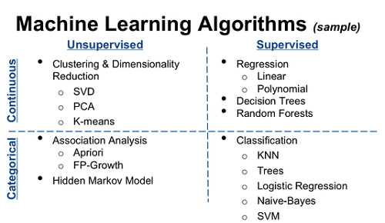
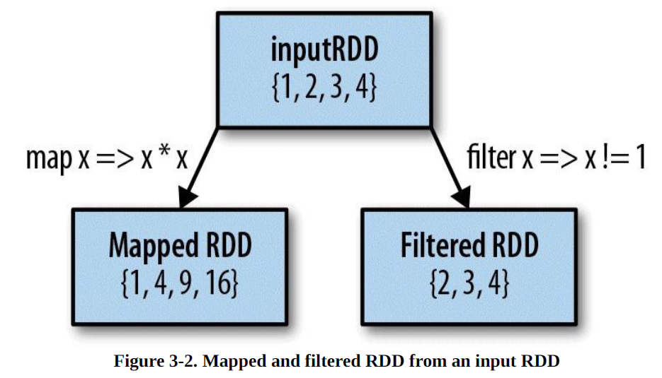
Apache Spark Component MLib
Apache Spark comes with two flavours of the machine learning library. They are spark.mllib and spark.ml.
The first one is developed on top of Spark's RDD abstraction, and the second one is developed on top of Spark's DataFrame abstraction.
It is recommended to use the spark.ml library for any future machine learning application developments.
MLlib is a machine learning library that provides various algorithms designed to scale out on a cluster for classification, regression, clustering, collaborative filtering, and so on.
These algorithms also work with streaming data, such as linear regression using ordinary least squares or k-means clustering (and more on the way).

Slide 13
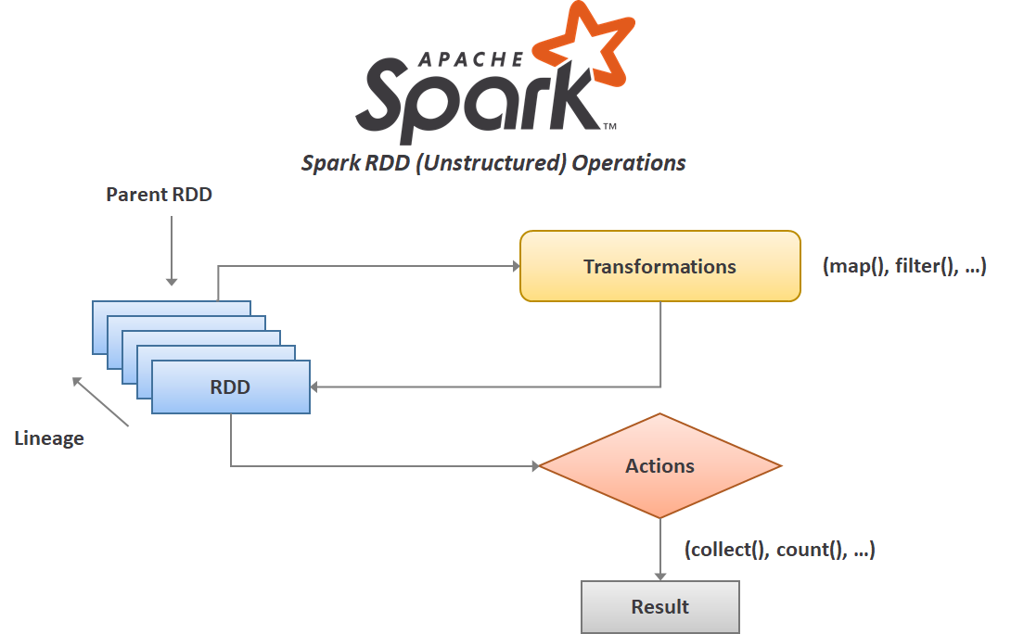
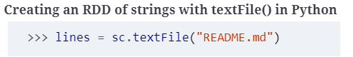
RDD Basics
A RDD in Spark is simply an immutable distributed collection of objects.
Each RDD is split into multiple partitions, which may be computed on different nodes of the cluster. RDDs can contain any type of Python, Java, or Scala objects, including user-defined classes.
Users create RDDs in two ways
by loading an external dataset
by distributing a collection of objects (e.g., a list or set) in their driver program.
We have already seen loading a text file as an RDD of strings using SparkContext.textFile(), as shown in Example.

Slide 14
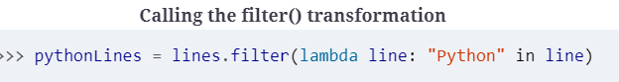
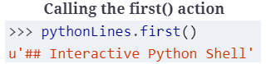
RDD Basics
Once created, RDDs offer two types of operations:
Transformations
Actions
Transformations construct a new RDD from a previous one. For example, one common transformation is filtering data that matches a predicate. In our text file example, we can use this to create a new RDD holding just the strings that contain the word Python as shown in Example.
Actions compute a result based on an RDD, and either return it to the driver program or save it to an external storage system (e.g., HDFS). One example of an action we called earlier is first(), which returns the first element in an RDD and is demonstrated in Example.

Slide 15
Properties of RDD
RDD which is a fault-tolerant collection of elements/ partitions that can be operated in parallel across the nodes.
Properties of RDD
Immutability
Cacheable – lineage – persist
Lazy evaluation (it different than execution)
Type Inferred
Two ways to create RDDs: parallelizing an existing collection in your driver program, or referencing a dataset in an external storage system, such as a shared filesystem, HDFS, HBase, S3, Cassandra or any data source offering a Hadoop InputFormat.
Input for Spark
External Store: HDFS, Hbase, Hive, S3, Cassandra, Ext3/ Ext4, NTFS
Data Formats: CSV, Tablimited, TXT, MD, Json, SquenceFile
Notes:
In object-oriented and functional programming, an immutable object (unchangeable object) is an object whose state cannot be modified after it is created.
JSON is a syntax for storing and exchanging data. JSON is text, written with JavaScript object notation.
Ext3 (the third extended filesystem) is the most commonly used filesystem on Linux. It is basically an extension of ext2 to which a journaling capability has been added. A filesystem is a way of organizing data on a computer system.
Ext4 is the evolution of the most used Linux filesystem, Ext3. In many ways, Ext4 is a deeper improvement over Ext3 than Ext3 was over Ext2. Ext3 was mostly about adding journaling to Ext2, but Ext4 modifies important data structures of the filesystem such as the ones destined to store the file data.
Type Inferred: Type inference refers to the automatic detection of the type of an expression in a formal language. These include programming languages and mathematical type systems, but also natural languages in some branches of computer science and linguistics.
MD files are the extensions of files created Markdown language software. Markdown is a lightweight markup language intended for one purpose, to be used to format text on the web with plain text formatting syntax.
NTFS, which stands for NT file system and the New Technology File System, is the file system that the Windows NT operating system (OS) uses for storing and retrieving files on hard disk drives (HDDs) and solid-state drives (SSDs).
Amazon S3 is an object storage service that stores data as objects within buckets. An object is a file and any metadata that describes the file. A bucket is a container for objects. To store your data in Amazon S3, you first create a bucket and specify a bucket name and AWS Region.
Lineage is an RDD process to reconstruct lost partitions. Spark not replicate the data in memory, if data lost, Rdd use lineage to rebuild lost data. Each RDD remembers how the RDD build from other datasets.
In Spark, lineage refers to the sequence of transformations applied to the Resilient Distributed Dataset (RDD) or DataFrame. Spark uses lineage information to recover lost data partitions in case of a failure, eliminating the need for data replication.
Lazy evaluation in storage refers to a strategy used in computing and data management where computations or operations on data are deferred until their results are specifically needed. Instead of immediately performing an operation when it's requested, the system delays the execution until the data is actually required for a subsequent computation or action.

Slide 16
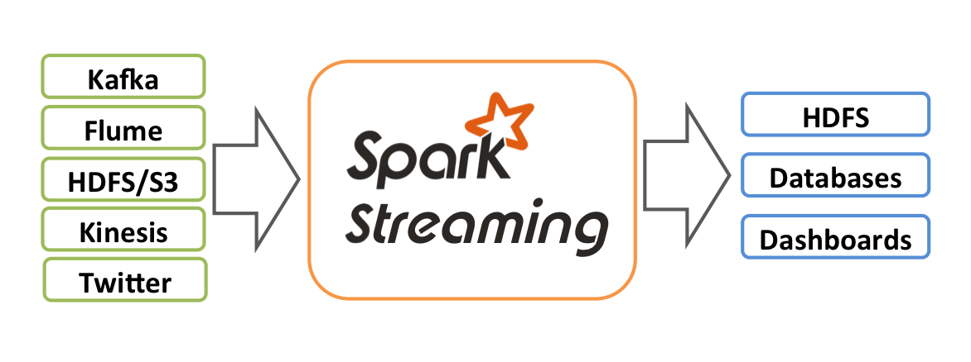
Spark File Based Input Methods
Spark’s file-based input methods, including textFile, support running on directories, compressed files, and wildcards.
You can use textFile("/my/directory"), textFile("/my/directory/*.txt"), and textFile("/my/directory/*.gz").
The textFile method also takes an optional second argument for controlling the number of partitions of the file.
Spark creates one partition for each HDFS block of the file, but you can also ask for a higher number of partitions by passing a larger value.
JavaRDD<String> distFile = sc.textFile("data.txt");
This is in contrast with textFile, which would return one record per line in each file.

Slide 17
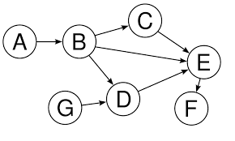
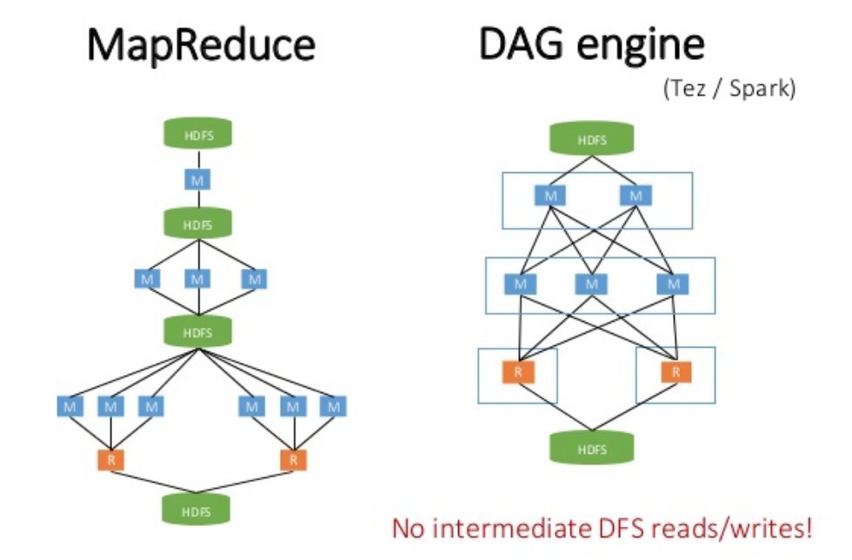
Comparison Spark and Mapreduce
Spark comes with a very advanced Directed Acyclic Graph (DAG) data processing engine.
A DAG of tasks is created to be executed by the engine and It consists of a set of vertices and directed edges connecting them.
In the MapReduce case, the DAG consists of only two vertices, with one vertex for the map task and the other one for the reduce task. The edge is directed from the map vertex to the reduce vertex.
The in-memory data processing combined with its DAG-based data processing engine makes Spark very efficient.
Spark comes with utilities that can give excellent visualization of the DAG of any Spark job that is running.

Slide 18

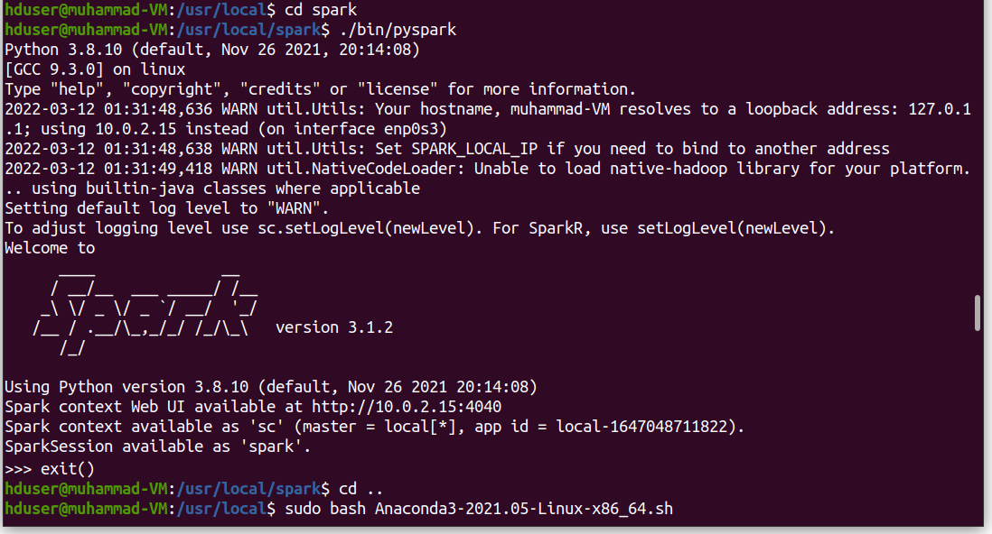
Spark Programming Paradigm
The Spark programming paradigm is very powerful and exposes a uniform programming model supporting the application development in multiple programming languages.
Apache Spark supports programming in Scala, Java, Python, and R even though there is no functional parity across all the programming languages supported.
Apart from writing Spark applications in these programming languages, Spark has an interactive shell with Read, Evaluate, Print, and Loop (REPL) capabilities for the programming languages Scala, Python, and R.
The Spark REPL is a very versatile tool that can be used to try and test Spark application code in an interactive fashion. The Spark REPL enables easy prototyping, debugging, and some other features.

Slide 19
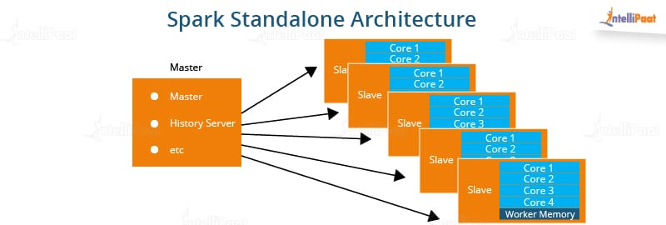
Spark Programming Paradigm
In any distributed application, it is common to have a driver program that controls the execution and there will be one or more worker nodes.
The driver program allocates the tasks to the appropriate workers.
In the case of a Spark application, its SparkContext object is the driver program and it communicates with the appropriate cluster manager to run the tasks.
The Spark master, which is part of the Spark core library, the Mesos master, and the Hadoop YARN Resource Manager, are some of the cluster managers that Spark supports.
In the case of a Hadoop YARN deployment of Spark, the Spark driver program runs inside the Hadoop YARN application master process or the Spark driver program runs as a client to the Hadoop YARN. Figure below describes the standalone deployment of Spark.

Slide 20
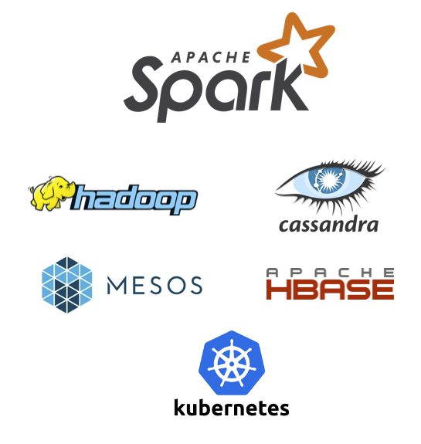
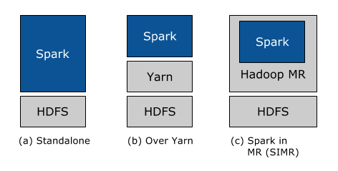
Spark and Hadoop Environment
Apache Spark is a cluster computing framework for large-scale data processing.
It does not use MapReduce as an execution engine and It uses its own distributed runtime for executing work on a cluster.
However, Spark has many parallels with MapReduce, in terms of both API and runtime.
Spark is closely integrated with Hadoop: it can run on YARN and works with Hadoop file formats and storage backends like HDFS.
Spark is best known for its ability to keep large working datasets in memory between jobs.
This capability allows Spark to outperform the equivalent MapReduce workflow.

Slide 21
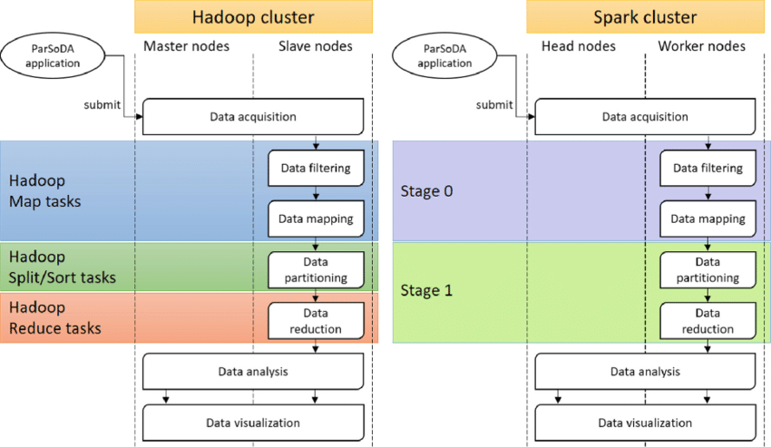
Spark and Hadoop Environment
Apache Spark provides the RDD and it supports distributed processing on a cluster of nodes. In case of failure of nodes during processing, the spark framework can handle this by using the RDD.
If there is a huge amount of data to be processed and there are nodes available in the cluster, the framework should have the capability to split the big dataset into smaller chunks and distribute them to be processed on more than one node in a cluster, in parallel.
Spark is designed from the ground up to have its basic dataset abstraction capable of getting split into smaller pieces deterministically and distributed to more than one node in the cluster for parallel processing, while handling the failures in the nodes.
Criteria | MapReduce | Spark
Processing Speeds | Good | Excellent (up to 100 times faster)
Data caching | Hard disk | In-memory / Local Disk
Perform iterative jobs | Average | Excellent
Independent of Hadoop | No | Yes
Machine learning applications | Average | Excellent

Slide 22




Spark and the Hadoop Environment
Data is expensive to move
e.g., loading to local R / Python / etc., engines
It is always better to do the computation where the data resides due to the following reasons
Security
Resources and etc.
Spark limits its scope to being a Computing Engine
Spark can read from and write to a wide variety of sources
HDFS
Hive
Kafka
Cassandra
S3 (and other Cloud)

Slide 23
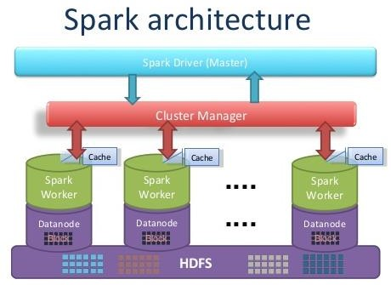
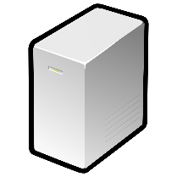
Apache Spark Architecture
Edge nodes are the interface between the Hadoop cluster and the outside network. For this reason, they are referred to as gateway nodes.

Slide 24
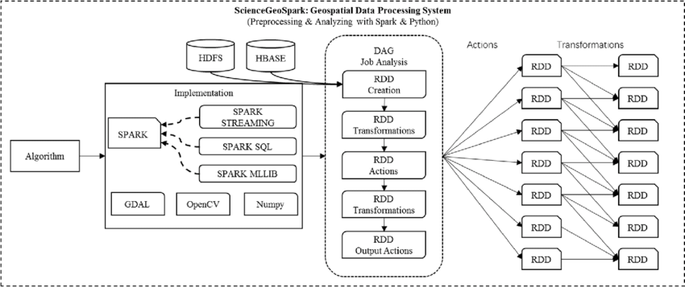
Spark Programming Model
In Functional Programming, the output of a function like mathematics function, only depends on the inputs to the function.
The same inputs will produce the same outputs in all circumstances
Declarative Programming Paradigm (like SQL)
Scala is the scalable, object-oriented, functional and statically typed language.
Compiles to Java bytecode
Supports Java libraries
Spark is written in Scala
Main programming language for Spark is Scala
Some APIs, e.g. GraphX, are only available in Scala
Notes:
Bytecode is the intermediate representation of a Java program, allowing a JVM to translate a program into machine-level assembly instructions. When a Java program is compiled, bytecode is generated in the form of a . class file.
A statically-typed language is a language (such as Java, C, or C++) where variable types are known at compile time.

Slide 25
Spark Programming Model
How is SparkR going to help the data scientists to do better data processing?
The data processing occurs on the single computer on which the R installation is available.
Moreover, if the data size is more than the main memory available on the computer, R will not be able to do the required processing.
With the SparkR package, there is access to a whole new world of a cluster of nodes for data storage and for doing data processing.
With the help of SparkR package, R can be used to access the Spark DataFrames as well as R DataFrames.
It is very important to know the distinction between the two types of data frames, R Dataframes and Spark Dataframes.
An R DataFrame is completely local and a data structure of the R language.
A Spark DataFrame is a parallel collection of structured data managed by the Spark infrastructure.

Slide 26
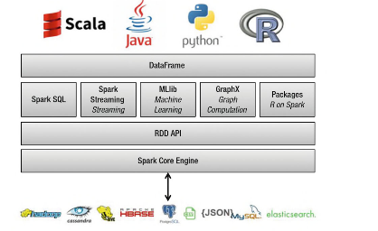
Spark Programming Model
When a Spark DataFrame is converted to an R DataFrame, it should fit in the available memory of the computer.
By converting an R DataFrame to a Spark DataFrame, the data can be distributed and processed in parallel.
By converting a Spark DataFrame to an R DataFrame, a lot of computations, charting, and plotting that is done by other R functions can be done.
In a nutshell, the SparkR package brings the power of distributed and parallel computing capabilities to R.
Spark with R can be used to process the entire raw data and finally, the aggregated and summarized data can be used to produce the reports, charts, or plots.
Because of Spark's ability to process data at scale, Spark with R can replace the entire ETL pipeline and do the desired data analysis with R. So Spark with R is a good alternative to packages such as dplyr.
Notes:
https://spark.apache.org/docs/latest/sparkr.html

Slide 27
Spark Programming with R
Other languages are available to work with Spark
Java (because it can use Scala libraries)
Python – using PySpark libraries that implement FP concepts (Check Tutorial 4)
R – two options: SparkR and SparklyR
PySpark is used extensively, and default sets of libraries tend to be installed on all worker nodes (numpy, scipy, sklearn, etc.) – e.g., Anaconda
SparkR is basically a tool for running R on Spark. In order to use SparkR, we simply import it in our environment and run our code. It is similar to Python except that it follows R's syntax rather than Python's. Almost everything available in Python is currently available in SparkR.
SparklyR is from creators of Dplyr, Tidy, etc. The SparklyR package is a tool for working with large datasets in an interactive environment. In this case, it is an R-based interface to Apache Spark, filtering and aggregating Spark datasets and then bringing them into R for analysis and visualization.
Notes:
FP: Functional programming

Slide 28
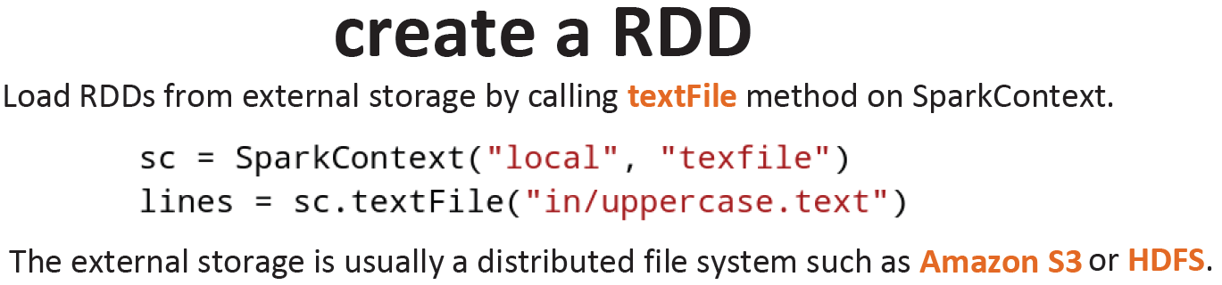
Spark Programming Model
Spark RDDs (Resilient Distributed Dataset)
Like a Collection object in Scala
Support functions as parameters
Immutable – once created, you can’t change it
Distributable – parts of the RDD are divided onto different JVMs
Lives in memory (unless it can’t!)
Strongly typed – using Java/Scala/Custom types
AccountNo | FirstName | LastName | AccountBalance
SB001 | John | Mathew | 250
SB002 | Tracy | Mason | 450
SB003 | Paul | Thomson | 560
This RDD would be of type RDD[(string, string, string, double)]
Notes:
The datatypes like int, float, bool, str, tuple, and Unicode are immutable. Datatypes like list, set, dict are mutable.

Slide 29
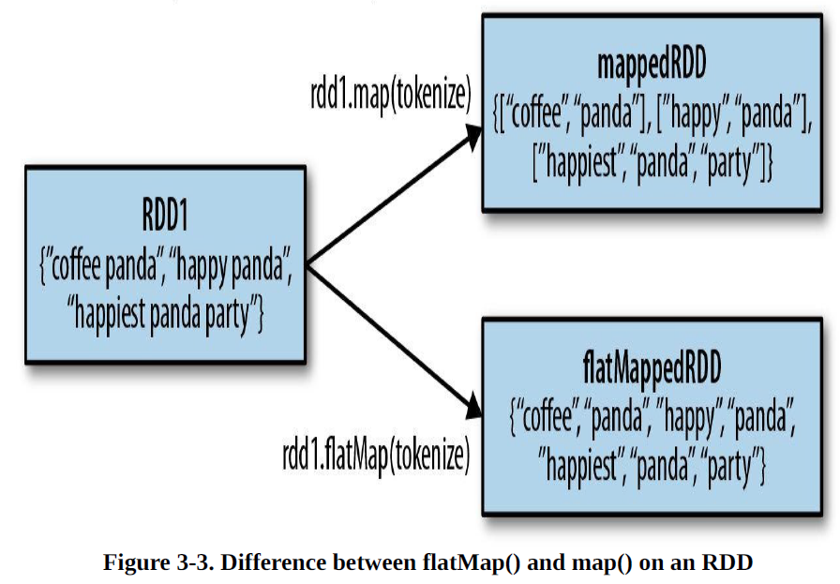
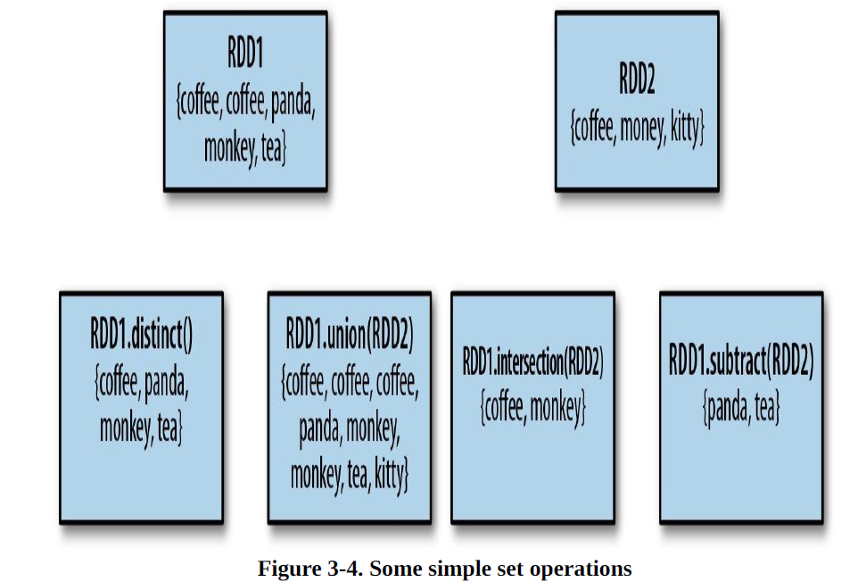
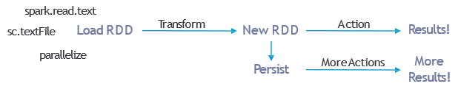
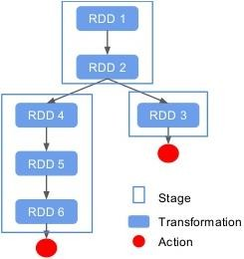
Spark Programming Model
Transformations
.filter(function)
.distinct()
.first()
.union()
.map(function)
.flatMap(function)
Actions
.reduce()
.count()
.persist()
.collect()
.saveAsTextFile()
.saveAsSequenceFile()
Notes:
Map and Reduce functions in Spark to not directly correspond
Map – takes one row and results in one row (transformation)
FlatMap – takes one row and results in 0 – several rows (transformation)
Reduce – performs specified function on data, e.g. add values (action)
ReduceByKey – works with key-value pairs to calculate and group (transformation)

Slide 30
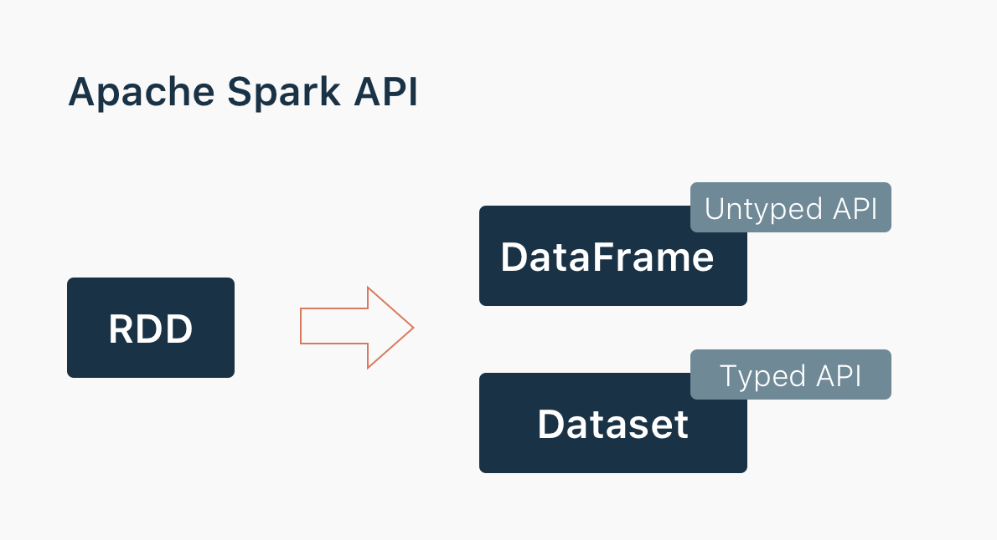
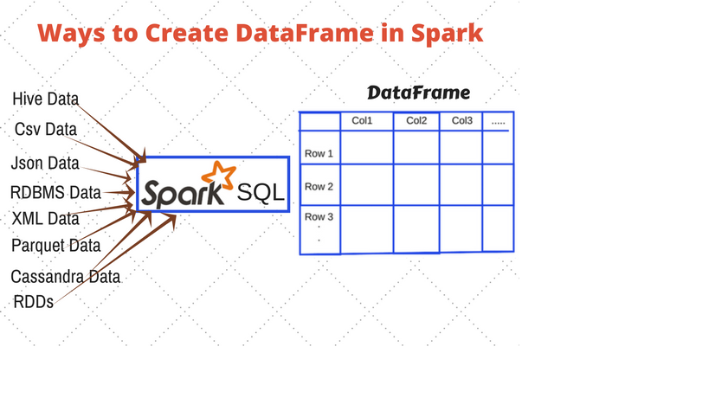
Dataframes and Spark SQL
Dataframe
Abstraction on top of RDDs
Basically, created RDD containing rows of columns
Has a schema
Rich, functional language for interaction (similar to Pandas/ Dplyr)
SparkSQL
Great way to interact with Dataframes!
Also works with Hive metabase
df = spark.sql("SELECT * FROM MYTABLE")

Slide 31
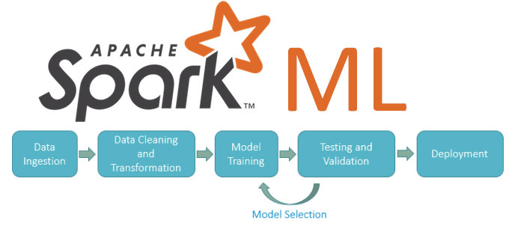
Spark ML
Currently, Spark has two machine learning libraries, Spark MLlib and Spark ML. Spark ML is the newer, scikit-learn inspired machine learning library and is where active development is taking place.
In addition to inheriting many of the performance considerations of the RDD and Dataset APIs that they are based on, these machine learning libraries have their own considerations as well.
The Spark ML API is built around the concept of a “pipeline” consisting of the different stages. Each stage performs a separate task, and stages exist for tasks ranging from data cleaning, to feature selection, through applying a machine learning algorithm.
For those familiar with scikit-learn much of the design will seem familiar. These pipeline stages are grouped into estimators and transformers.
Estimator: An algorithm that trains on the data provided in a Spark DataFrame and creates a model called as a Transformer
Transformer: Converts a Spark DataFrame containing features and transforms it to another Spark DataFrame containing predictions.
Parameter: Used by the Estimators and Transformers. Usually specific to the machine learning algorithm. Spark ML comes with a uniform API for specifying the right parameters to the algorithms.
Pipeline: This is a chain of Estimators and Transformers working together forming a machine learning workflow.

Slide 32
Resources/ References
Learning Spark, Holden Karau, Andy Konwinski, Patrick Wendell, Matei Zaharia, O'Reilly Media, Inc., 2015.
Spark in Action, Second Edition, Jean-Georges Perrin, Rob Thomas, Manning Publishers, 2020.
Lublinsky B., Smith K. T. and Yakubovich A 2013, Professional Hadoop Solutions, Wrox [ISBN: 13:978-11186]
Holmes A 2012, Hadoop in Practice, Manning Publications [ISBN: 13:978-16172]
McKinney W. 2012, Python for Data Analysis, O'Reilly Media [ISBN: 13: 978-14493]
https://hadoop.apache.org/docs/stable/hadoop-mapreduce-client/hadoop-mapreduce-client-core/MapReduceTutorial.html
Some images are used from Google search repository (https://www.google.ie/search) to enhance the level of learning.
Copyright Notice The following material has been communicated to you by or on behalf of CCT College Dublin in accordance with the Copyright and Related Rights Act 2000 (the Act). The material may be subject to copyright under the Act and any further reproduction, communication or distribution of this material must be in accordance with the Act. Do not remove this notice

